Slide 1
Community Health Workers:
Moving Research Forward
Community Engagement & Collaboration Core
2019
Center for Clinical
and Translational Sciences
University of Illinois at Chicago
2019

Slide 2
Welcome!

Slide 3
Talk about it...
Meet your neighbor. Talk about:
Where you work
What kind of work you do
What you like about your job

Slide 4
Moving Research Forward: Why We’re Here
Communities and Health | Science | Scientific Research | Participant Rights | Research and the Community

Slide 5
Community
Health Workers:
Moving Research Forward

Slide 6
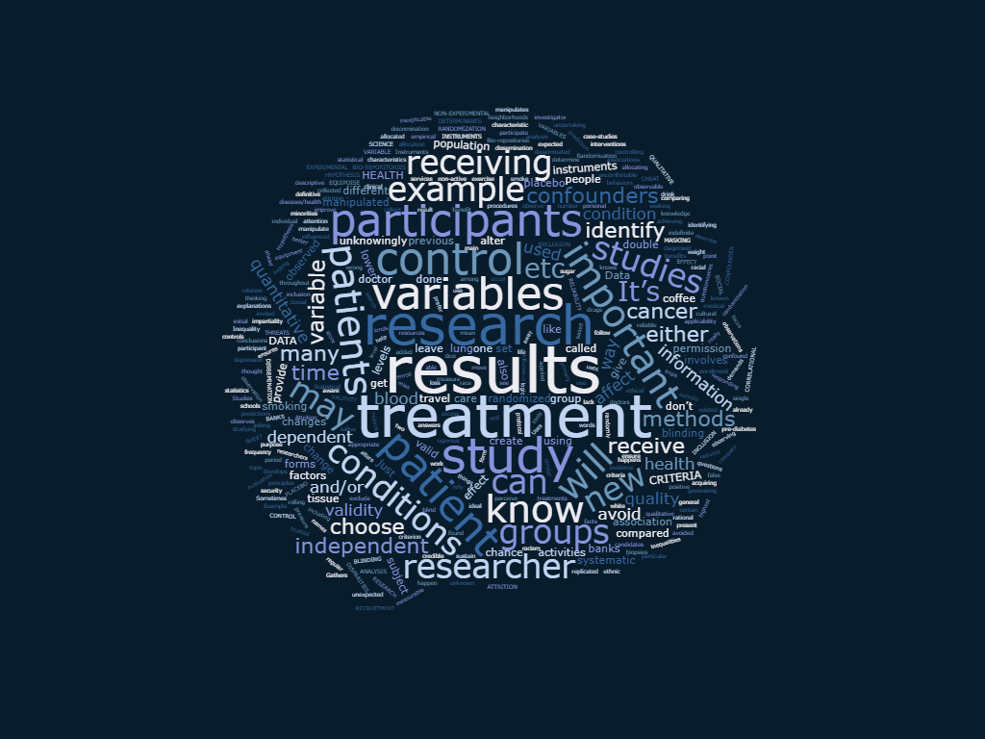
What do you think of when you hear the word research?

Slide 7
What is the goal for CHWs?
Understand what goes into research
Feel comfortable talking about research
Think about joining a research team in the future
Be a voice for the community in a new way
Share expert opinions and influence future research

Slide 8
Moving Research Forward: Why We’re Here
Communities and Health | Science | Scientific Research | Participant Rights | Research and the Community

Slide 9
Communities and Health

Slide 10
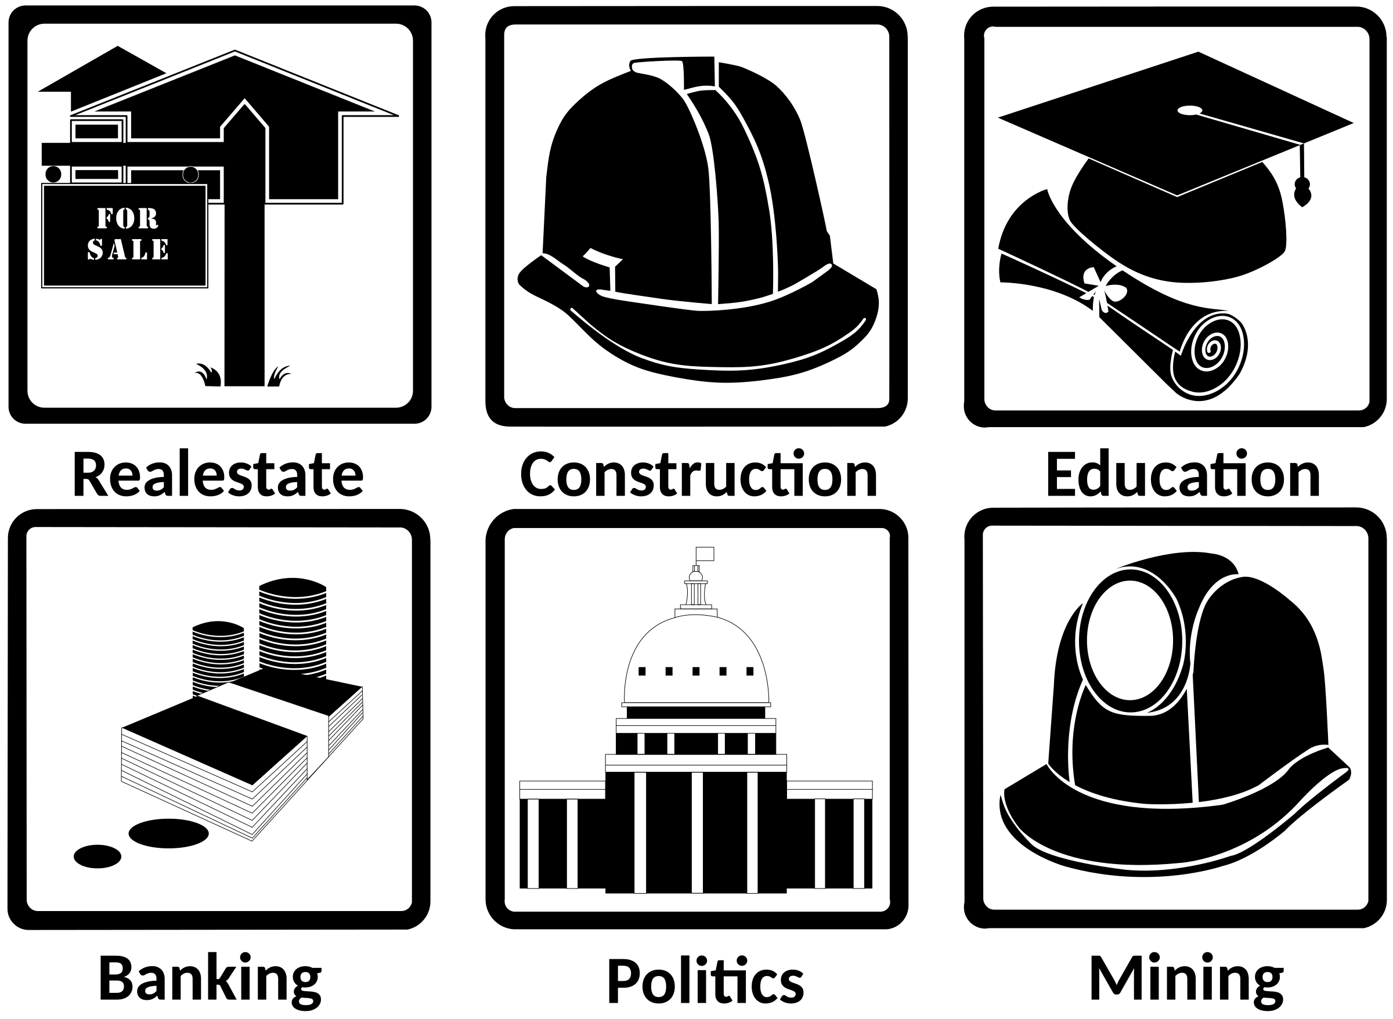
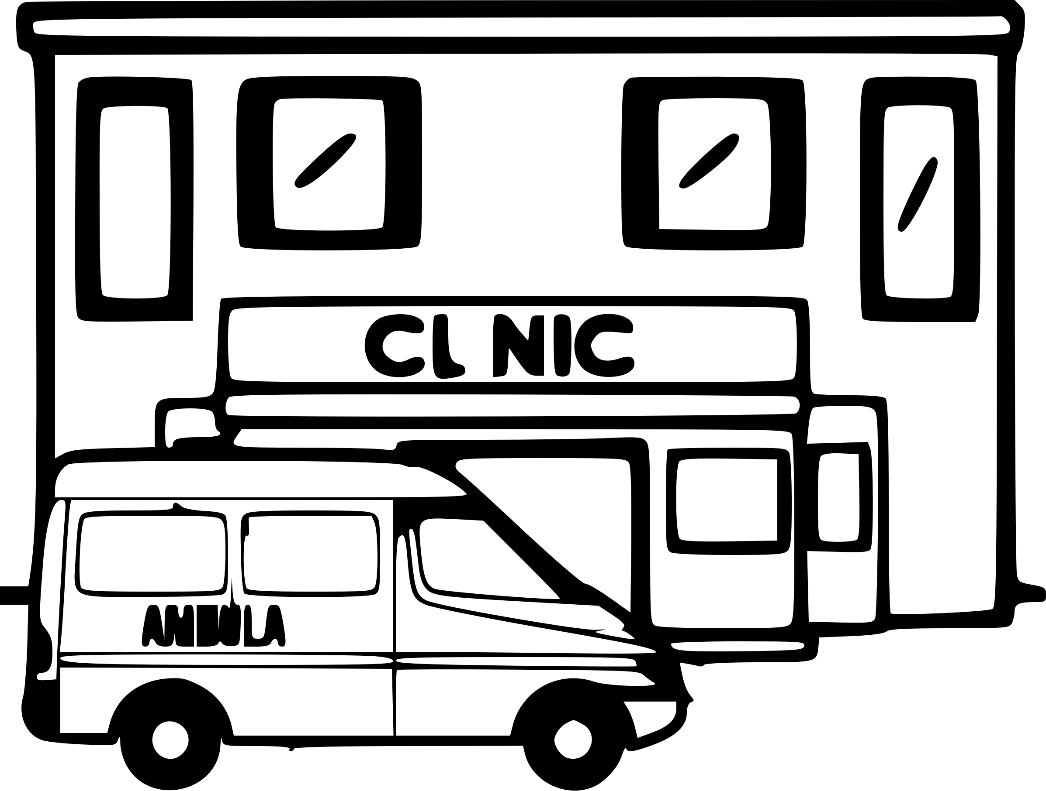
What affects our health?

Slide 11
Place...
How safe is the neighborhood?
Is the air clean?
Is the water clean?
Do you have green spaces?

Slide 12
Schools...
How much money do the schools have?
Where are the schools?
Do the schools have books?
What are the teachers like?
Are there after school programs?

Slide 13
Food...
Are there grocery stores in the neighborhood?
Does food cost a lot of money?
Is the food healthy?

Slide 14
Jobs...
Are there jobs in the neighborhood?
What about buses or trains to get to a job?
Do the jobs pay fairly? Do they have benefits?
Are the jobs safe?

Slide 15
Health...
Are there clinics and hospitals nearby? How far are they?
How much money does it cost to see a doctor or go to the hospital?

Slide 16
What are other questions we might have about where we live?

Slide 17
Healthy lives
💭 Read about the two boys and think about their situations...
Image by arthurpalac from Pixabay

Slide 18
What is each environment like?

Slide 19
Let’s jump ahead 15 years...

Slide 20
Differences in communities
Social Determinants of Health
How where we live, work, and have fun affect our health
Health disparity
A difference between two or more things, often an unfair one, that affects how healthy we are
Health inequalities
The types and numbers of diseases and sickness are not the same from group to group

Slide 21
Differences in communities
An area of a city has less resources and more violence
Community violence makes it physically and mentally (trauma) unsafe for residents compared to other neighborhoods
People have trauma related issues such as substance use, learning challenges, or anxiety, etc. that affect their quality of life or life span because of where they live
Notes:
http://vpc.org/studies/trauma17.pdf

Slide 22
Differences in communities
Social Determinants
of Health
Health Disparities
Health Inequities
An area of a city has less resources and more violence
Community violence makes it physically and mentally (trauma) unsafe for residents compared to other neighborhoods
People have trauma related issues such as substance use, learning challenges, or anxiety, etc. that affect their quality of life or life span because of where they live
Notes:
http://vpc.org/studies/trauma17.pdf

Slide 23
Let’s look at another example...
Health inequalities
Sickness and diseases that are not the same from group to group
Risk for moms
dying in childbirth in Chad
1 in 16 women
Risk for moms
dying in childbirth in Sweden
Less than 1 in 10,000 women
Notes:
https://www.who.int/features/factfiles/health_inequities/en/
https://www.citylab.com/equity/2017/06/the-dramatic-health-disparities-between-rich-and-poor-americans/529245/

Slide 24
What about the United States?
🗺
Notes:
https://www.who.int/features/factfiles/health_inequities/en/
https://www.citylab.com/equity/2017/06/the-dramatic-health-disparities-between-rich-and-poor-americans/529245/

Slide 25
What are some of the issues here in the United States?
March, 2018

Slide 26
How can we
decrease these inequalities?
Notes:
https://news.wttw.com/2017/03/23/survey-reveals-alarming-health-disparities-chicago-neighborhoods

Slide 27
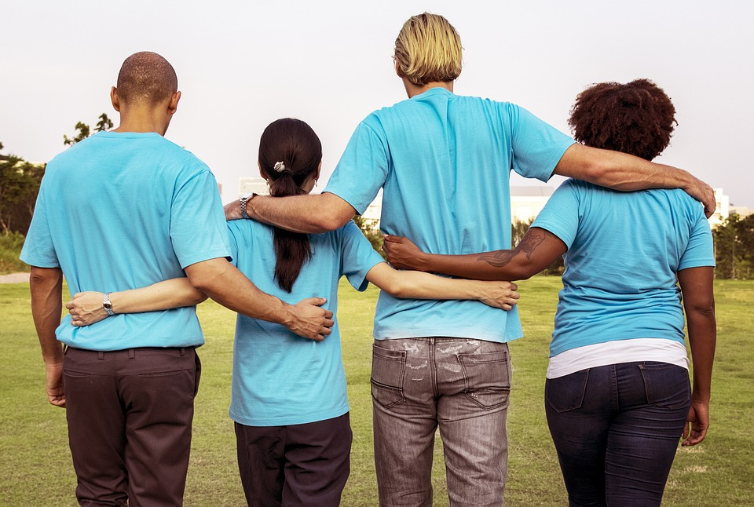
Why study people from more groups and communities?
Image by rawpixel from Pixabay

Slide 28
Studying people from more groups and communities...Why?
Better understand how health disparities affect people
Find better ways to help people in different groups or communities who might need different things
Help more people altogether

Slide 29
Who do researchers study?
People who:
Live in different places
Have different races/ethnicities/genders
Are different ages
Have different diseases
Speak different languages
Went to different schools or different kinds of schools

Slide 30
Studying different groups
✎ The average lifespan in 2016 was about 78 years old in the United States...
What do you think the lifespan is in a big city like Chicago?
It depends...

Slide 31
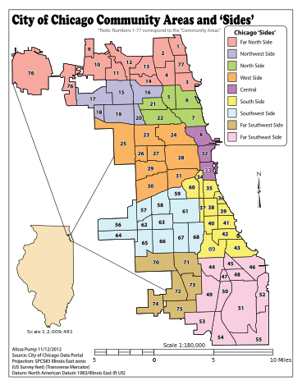
Two areas
in Chicago
Downtown
West Side
https://en.wikipedia.org/wiki/Community_areas_in_Chicago
Notes:
https://news.wttw.com/2018/04/10/chicago-hospitals-strive-increase-life-expectancy-west-side

Slide 32
Two areas in Chicago
West Side
Downtown
85 years old
69 years old
https://en.wikipedia.org/wiki/Community_areas_in_Chicago
Notes:
https://news.wttw.com/2018/04/10/chicago-hospitals-strive-increase-life-expectancy-west-side

Slide 33
Two neighborhoods in Chicago
Downtown
neighborhood,
Streeterville
South Side neighborhood, Englewood
90 years old
60 years old
https://en.wikipedia.org/wiki/Community_areas_in_Chicago
Notes:
https://www.chicagotribune.com/business/ct-biz-chicago-has-largest-life-expectancy-gap-between-neighborhoods-20190605-story.html

Slide 34
Are you surprised? Why or why not?
Notes:
http://www.dse.vic.gov.au/effective-engagement/introduction-to-engagement/what-is-community-engagement

Slide 35
Feelings about Research

Slide 36
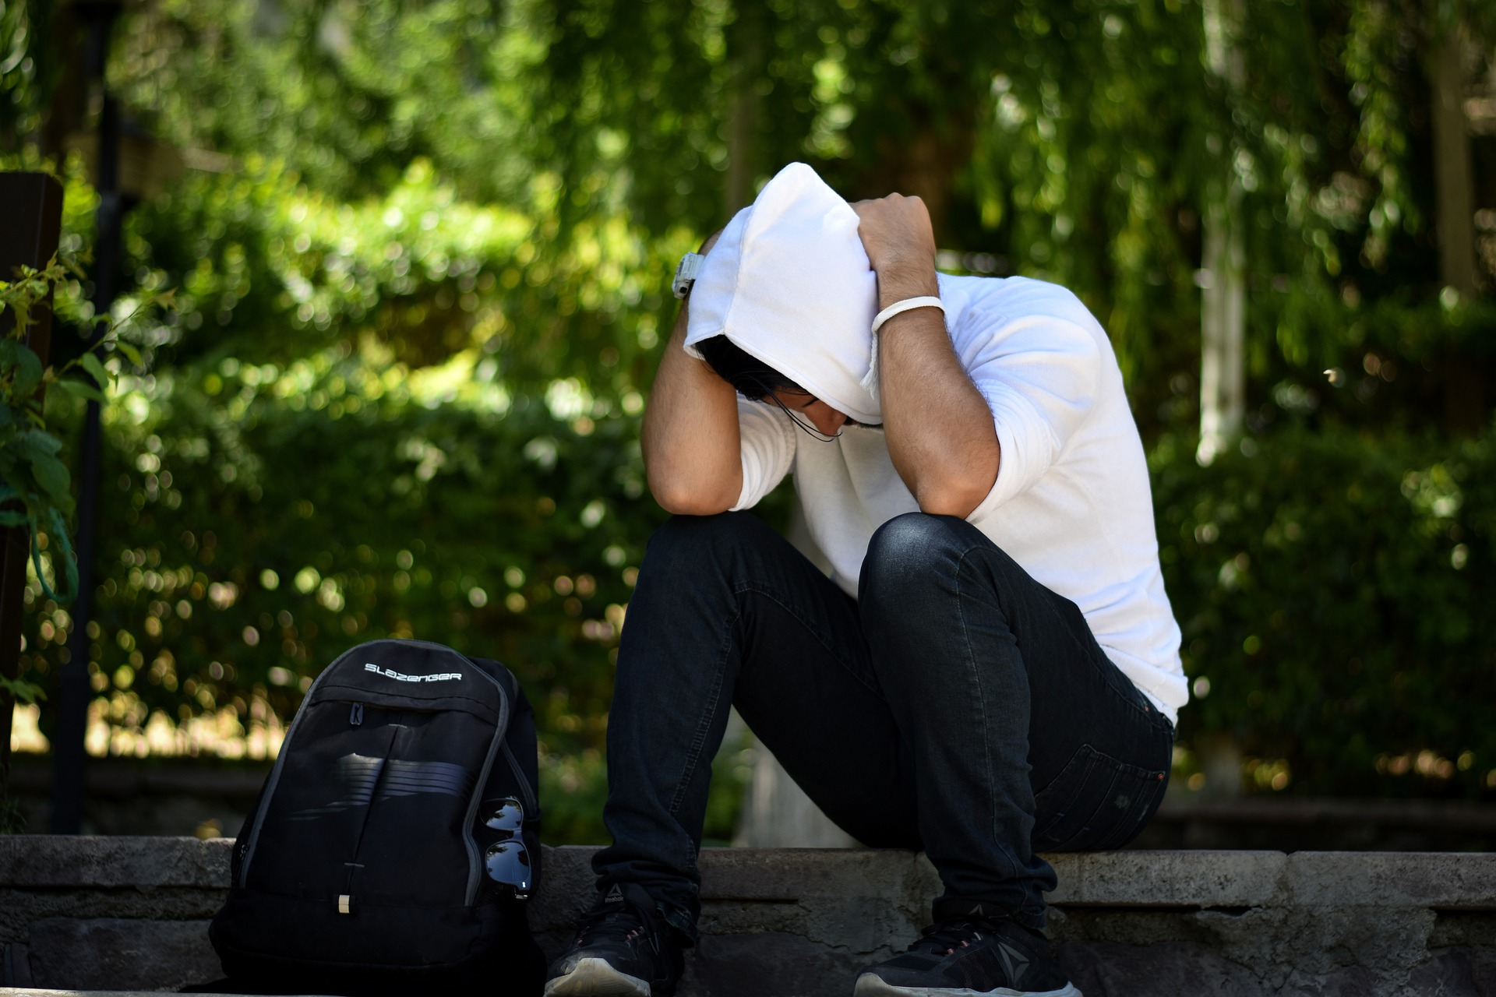
I have doubts...

Slide 37
What are some reasons people might say NO to research?
Notes:
https://www.cdc.gov/minorityhealth/CHDIReport.html#anchor_1547838233

Slide 38
Why do people have doubts?
Don’t trust doctors or hospitals
Don’t know how to find out about research
Don’t always understand researchers
Have questions about the ethics of research
???

Slide 39
Community Health Workers:
Moving Research Forward
Your role is key to moving research forward!

Slide 40
Science

Slide 41
What does the word science make you think of?
Notes:
Brainstorm kinds of science people have heard of..

Slide 42
How do you learn new things?
I saw/read/heard/
smelled/tasted/felt...
It’s always been like this…
Well, the experts say...
I did an experiment to learn...
I follow my gut...
It seems like it makes sense to...

Slide 43
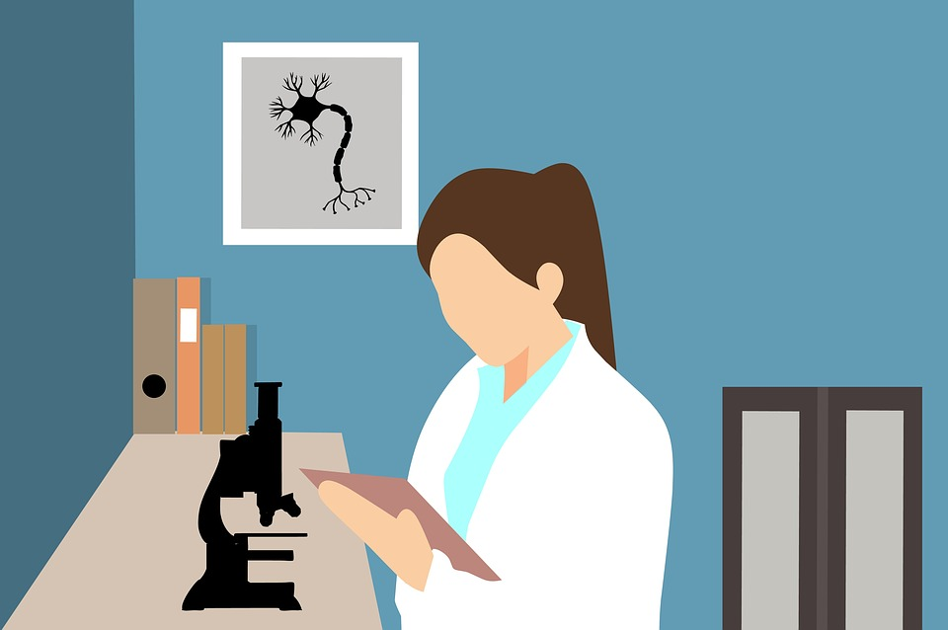
What is science then?
The process of thinking and trying to solve problems so that we can understand the world around us

Slide 44
Finding new information
Think about a time you
wanted to know the answer to a question.
What did you do? Where did you go to get the information you needed?

Slide 45
Thinking like a researcher
You might:
Ask questions and look for answers
Watch and listen
Make an educated guess, based on what you know so far
Try different ideas
Decide if the new ideas make sense or not

Slide 46
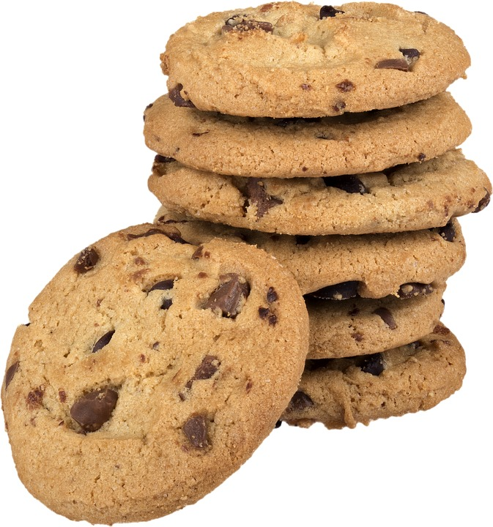
How we know if something works
Marta makes some cookie dough.
Before she puts the cookies in the oven, she realizes she forgot she had an appointment.
She puts the cookie dough in the fridge.
Notes:
https://www.sciencebuddies.org/science-fair-projects/project-ideas/FoodSci_p014/cooking-food-science/how-do-you-make-the-best-cookie

Slide 47
How we know if something works
A few days later, she remembers the cookie dough…so she makes the cookies.
Her family tells her they are the best cookies she has ever made.
Notes:
https://www.nytimes.com/2008/07/09/dining/09chip.html?_r=1&ex=1216353600&en=2e81fc73c88f55bf&ei=5070&emc=eta1&oref=slogin
https://www.sciencebuddies.org/science-fair-projects/project-ideas/FoodSci_p014/cooking-food-science/how-do-you-make-the-best-cookie

Slide 48
How we know if something works
She thinks about what was different.
This time, she kept the dough in the refrigerator because she had to leave...
Notes:
https://www.nytimes.com/2008/07/09/dining/09chip.html?_r=1&ex=1216353600&en=2e81fc73c88f55bf&ei=5070&emc=eta1&oref=slogin
https://www.sciencebuddies.org/science-fair-projects/project-ideas/FoodSci_p014/cooking-food-science/how-do-you-make-the-best-cookie

Slide 49
How we know if something works
She does a little googling and she decides to do an experiment:
She makes some dough. She:
Bakes some of it right away
Puts some of it in the refrigerator and bakes it 12 hours later
Puts some of it in the refrigerator and bakes it 2 days later
Notes:
https://www.nytimes.com/2008/07/09/dining/09chip.html?_r=1&ex=1216353600&en=2e81fc73c88f55bf&ei=5070&emc=eta1&oref=slogin
https://www.sciencebuddies.org/science-fair-projects/project-ideas/FoodSci_p014/cooking-food-science/how-do-you-make-the-best-cookie

Slide 50
How we know if something works
She asks her family and neighbors to taste each batch and tell her their favorite.
Notes:
https://www.nytimes.com/2008/07/09/dining/09chip.html?_r=1&ex=1216353600&en=2e81fc73c88f55bf&ei=5070&emc=eta1&oref=slogin
https://www.sciencebuddies.org/science-fair-projects/project-ideas/FoodSci_p014/cooking-food-science/how-do-you-make-the-best-cookie

Slide 51
How we know if something works
Wow! She decides that the cookies with the dough in the refrigerator for 48 hours were the best — everyone picked those cookies!
She shares the new baking trick with all of her friends who like to bake!
Notes:
https://www.nytimes.com/2008/07/09/dining/09chip.html?_r=1&ex=1216353600&en=2e81fc73c88f55bf&ei=5070&emc=eta1&oref=slogin
https://www.sciencebuddies.org/science-fair-projects/project-ideas/FoodSci_p014/cooking-food-science/how-do-you-make-the-best-cookie

Slide 52
The Scientific Method
Report
Theory
Information already available
Share what you learned
Data
New question
Collect information and see what you learned
Ask new question and search related information
Test it
Hypothesis
Decide how to test your hypothesis and see if you are right
Predict based on your research

Slide 53
More about the scientific method
The person studying a problem looks at:
What other people have studied before
What they learned
Asks new question
Makes a prediction...
The hypothesis is what he/she thinks will happen.
He/She tries to prove it is true.

Slide 54
More about the hypothesis
The hypothesis is:
Clear and easy to follow
Testable
Made so that only one thing changes at a time

Slide 55
Marta’s hypothesis
Cookies will taste better if you wait to bake the cookie dough.

Slide 56
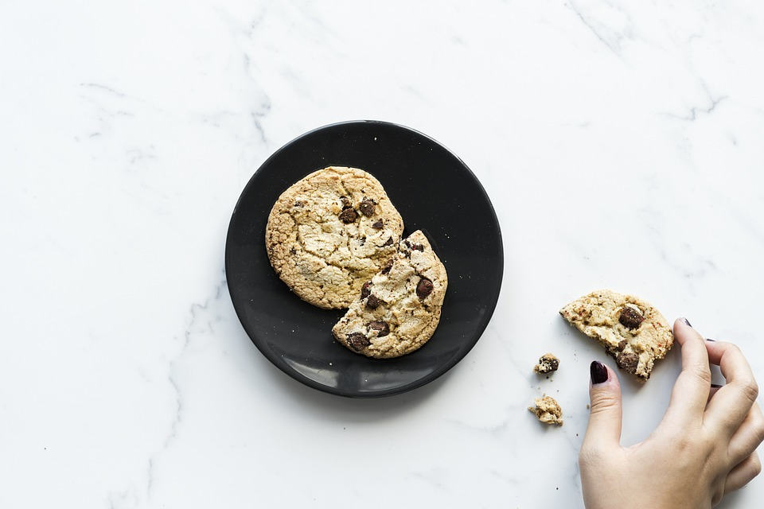
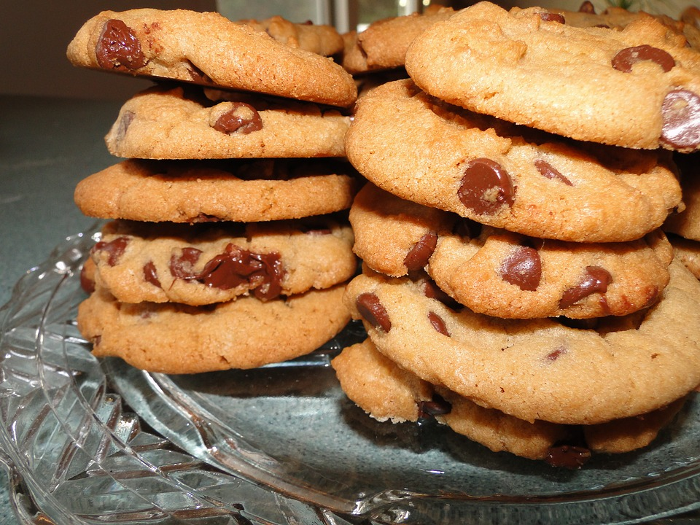
Variables
Independent Variable | One thing that changes | Time in the fridge before baking
Dependent Variable | What happens because of the thing that changes | Better tasting cookie
Controlled Variables | Everything else in an experiment which stays the same | Baking time, ingredients, amount of dough

Slide 57
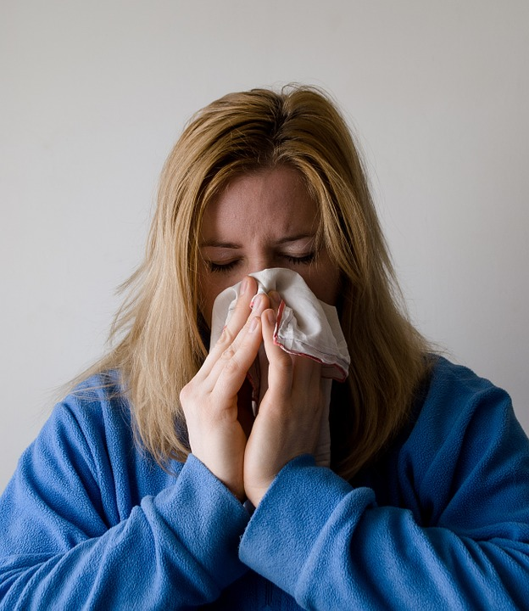
Strange results...
Sometimes the researcher might not understand the results.
Maybe Marta’s sister has a cold and it has affected her taste buds...She thinks all the cookies taste bad.
Confounders!!!
Notes:
Set up example for confounders: A study evaluating the effect of caffeine in lung cancer.
How would you do it? What would you use to measure caffeine?
What is the independent variable” The dependent variable? What variables would you control?
Refer to smoking as a confounder.

Slide 58
Strange results...
Her sister’s cold is a confounder - an unplanned thing that makes the results confusing
Confounders!!!
Notes:
Set up example for confounders: A study evaluating the effect of caffeine in lung cancer.
How would you do it? What would you use to measure caffeine?
What is the independent variable” The dependent variable? What variables would you control?
Refer to smoking as a confounder.

Slide 59
Let’s try our own experiment...

Slide 60
Scientific Research

Slide 61
What is scientific research like today?
Notes:
https://www.cdc.gov/minorityhealth/CHDIReport.html#anchor_1547838233

Slide 62
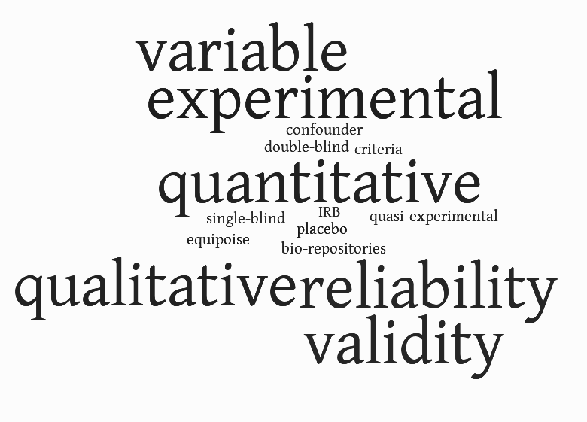
What is research like today?

Slide 63
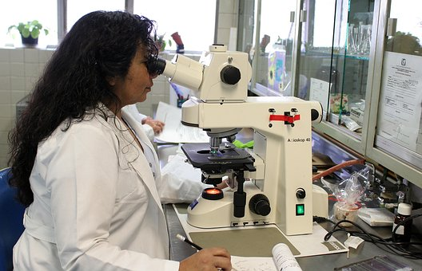
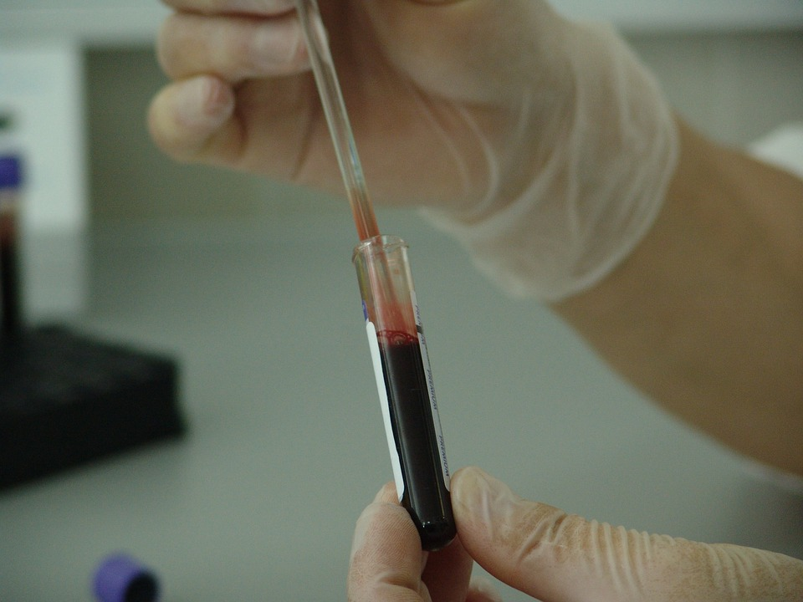
Who is involved in research?

Slide 64
What is research like today?
Needs repeatable results
Needs to make sure there is no bias
Looks to find if the medicine or treatment actually works
Keeps people safe from harm

Slide 65
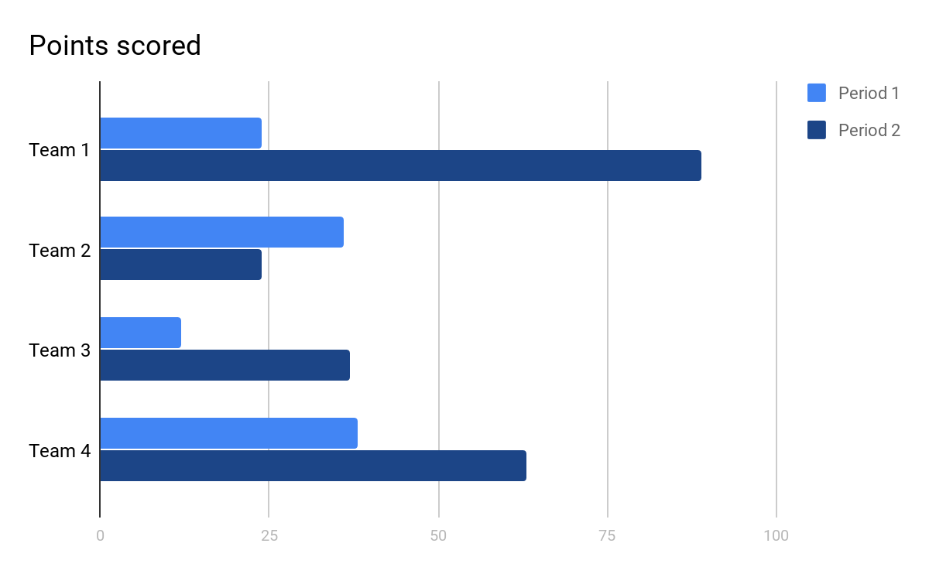
Different kinds of information
Qualitative
Look for new ideas or patterns to study more later
Looks for ideas
Looks to see what a lot of people are saying
Looks to see what a lot of people are doing
Uses quotes from the research to support ideas
Looking for connections between different factors
🗫
Quantitative
Measure what you want to learn
Uses numbers
(20% of people, 5 out of 10 people, etc.)
Uses graphs or charts
Proves an idea
Based on educated guesses

Slide 66
Different Kinds of Research

Slide 67
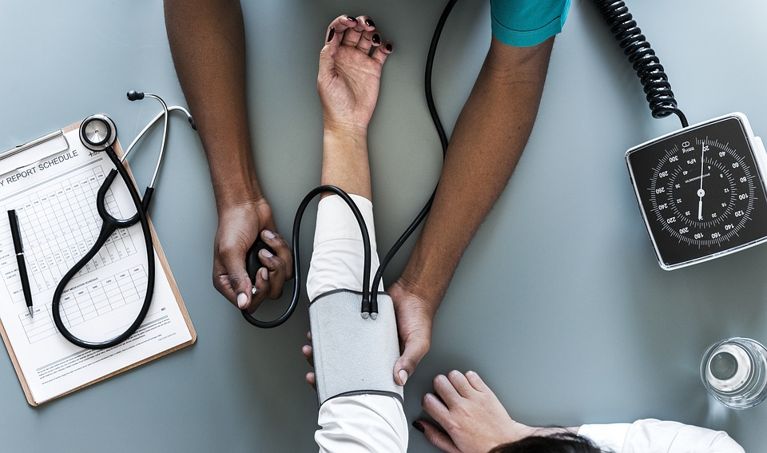
Different types of research
Qualitative (Descriptive) | Quantitative (Measurable or Countable)
Watch a situation Interview people Have focus groups | Give surveys or answer questions Compare measurements Study changes in the body

Slide 68
Qualitative or Quantitative?
Decide which examples show qualitative and quantitative research.

Slide 69
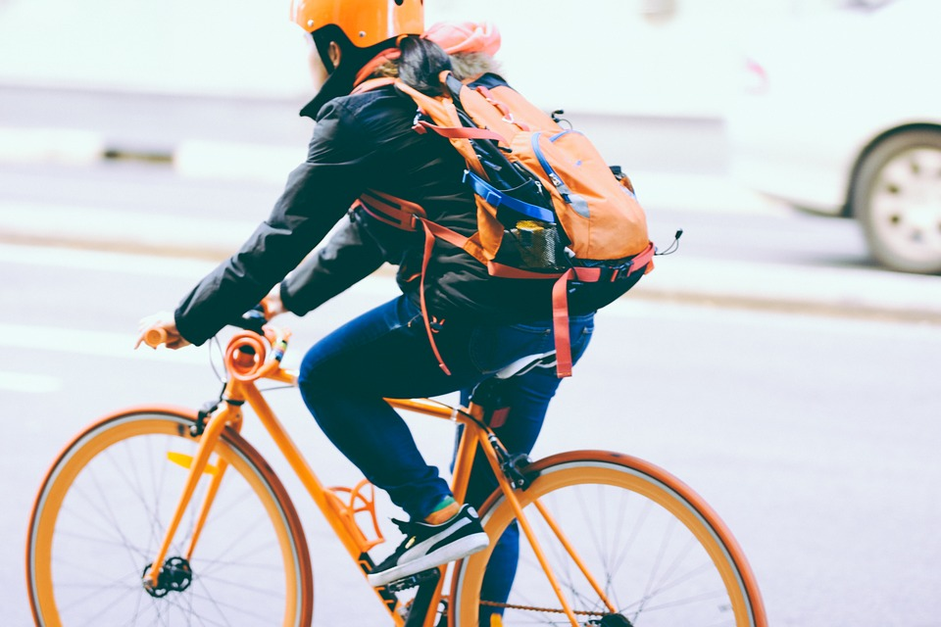
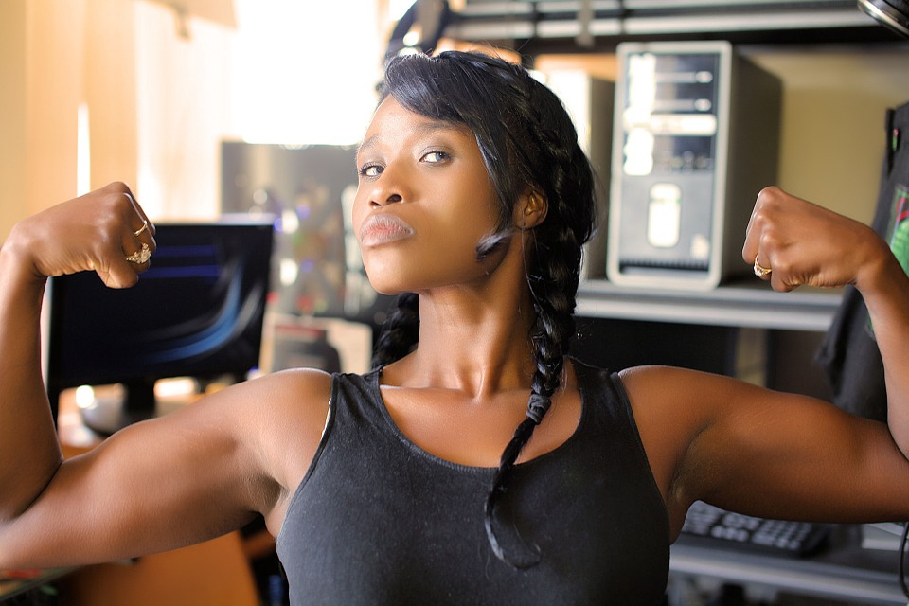
Different types of research
Non-Experimental 1 intervention, unblinded | Quasi-Experimental 2 different interventions, unblinded | Experimental 2 different interventions, double-blind
A researcher studies if riding a bike for one hour everyday helps people with prediabetes. | A researcher studies if riding a bike for one hour everyday or weightlifting better helps people with prediabetes. | A researcher studies if a new pill helps people with prediabetes better than the current pill. No one knows what pill they get.

Slide 70
Different types of research - Non-Experimental
Cross-Sectional Study | Longitudinal Study
Like taking a picture, finding information for a moment in time 📷 Example: Studying how many miles a day people walk who live in different areas or belong to different groups | Tracking information over a long period of time (years) 📅 Example: Studying people who walk X amount of miles per day and the impact on their health over time

Slide 71
Let’s try...cross-sectional or longitudinal?
Daniel is in a study about sons and fathers. Once a year, he has to answer questions about how much time he and his father spend together, what they have in common, etc. He has been doing the study since he was 10 years old...He’s now 17.
This is an example of____________________.

Slide 72
Let’s try...cross-sectional or longitudinal?
Daniel is in a study about sons and fathers. Once a year, he has to answer questions about how much time he and his father spend together, what they have in common, etc. He has been doing the study since he was 10 years old...He’s now 17.
This is an example of a longitudinal study.

Slide 73
Non-Experimental Unblinded research
Researcher and patient understand what the medicine or activity is
They know if they are doing it or getting it
One single group

Slide 74
Quasi-Experimental Studies
Compares two groups
Each group receives different treatment
Participants and researchers know what is the medicine they are taking

Slide 75
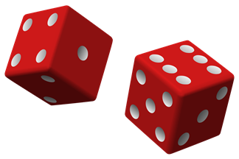
Choosing people
Some studies are randomized:
Participants are assigned to each group by chance.
Gives everyone the same chance to get the treatment (it’s not up to the researcher!)
Makes sure research is unbiased
Compare today’s treatments to newer treatments (which one should be the “best” one?)

Slide 76
Bias: To favor one group over another, either consciously or not
Equipoise
Researcher’s uncertainty over whether a treatment will be effective or not...this ensures they won’t be biased

Slide 77
Blinded Research: Single or Double
The researcher or patient doesn’t know who gets the medicine
The researcher and patient don’t know who gets the medicine.
❔ ❔
❔
❔

Slide 78
Triple blind studies
When the participant, the researcher, and the person looking at the data don’t know who is getting the medicine
❔ ❔
❔

Slide 79
Let’s try...
Linda participates in research about diabetes. She takes a special pill every day for 2 months. She doesn’t know if the pill has medicine in it or not.
If the researcher knows if she is taking medicine or not, then this is
____________ blind study.

Slide 80
Let’s try...
Linda participates in research about diabetes. She takes a pill every day for 2 months. She doesn’t know if the pill has medicine in it or not.
If the researcher knows if she is taking medicine or not, then this is a single blind study.

Slide 81
The placebo effect
Often, people really hope to feel better. But maybe they just got a sugar pill that looks like medicine.
Sometimes, though, they do feel better. This is called the placebo effect.

Slide 82
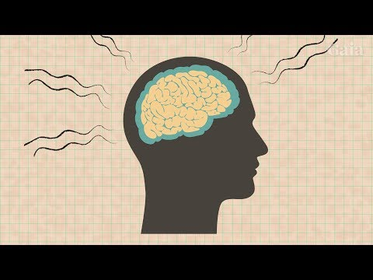
The Placebo Effect

Slide 83
Measuring and Keeping Track of Information

Slide 84
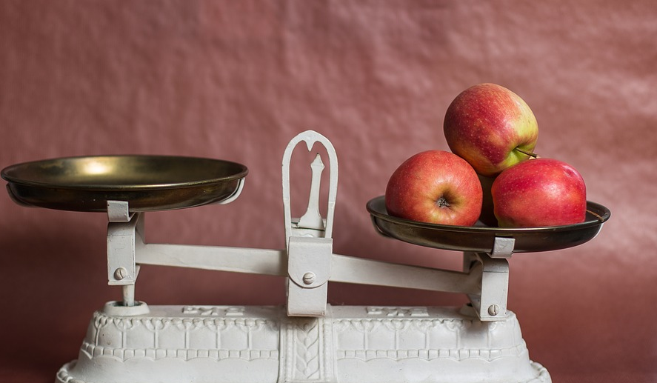
Measuring information correctly
Validity
How well a tool measures what it is supposed to measure
Reliability
How consistent the tool is that is used to measure
Notes:
Validity: can use the example of the scale. Scale can be 5 lbs off, therefore NOT valid. Yet, always reliable in that it is ALWAYS 5 lbs off!

Slide 85
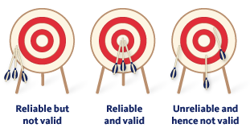
Information in studies
Notes:
Validity: can use the example of the scale. Scale can be 5 lbs off, therefore NOT valid. Yet, always reliable in that it is ALWAYS 5 lbs off!

Slide 86
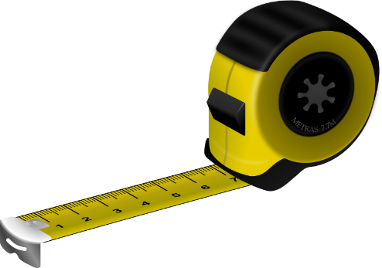
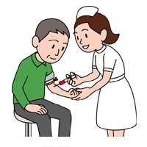
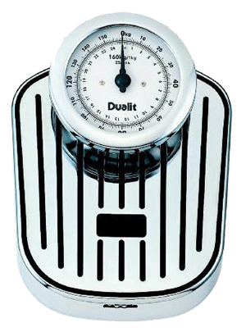
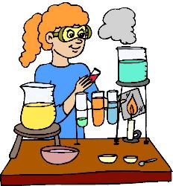
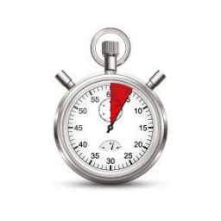
Tools for Measuring

Slide 87
Tools for Measuring
Type of Tool | Examples of What Can Be Measured
Paper forms | Shows information about what people know, personal information, or how people act
Scale | Shows how much people weigh
Measuring tape | Shows how tall someone is or waist size
Sphygmomanometer | Shows blood pressure
Blood draw needle | Shows how much blood is being drawn from a person
Lab work | Shows how much cholesterol is in blood, the levels or blood sugar, or more
Timer | Shows how long it takes to walk or how many heartbeats in an amount of time

Slide 88
Collecting information
Sometimes before and after the medicine or activity
Sometimes during the process
Always follow rules
about collecting and storing information!

Slide 89
What do they collect? Where does it go?
They collect blood, saliva and other types of human tissue or information
Keep it in places called bio-repositories or data banks where they are kept safe

Slide 90
How is information stored?
No names are attached to your information
Sometimes, samples are used for other studies, too, but only if the person said it was okay

Slide 91
Keeping track of information helps...
Make sure you have proof that the experiment actually works
Understand why things happened
Creates a record in case you need to go back

Slide 92
Ideas about research
✎ You are chatting with different people at a party and they ask what you do.
Take a look at some ideas they may have about research and think about what you might say.

Slide 93
Participant Rights

Slide 94
Keeping people safe:
The Milgram Experiment

Slide 95
What kind of rights do participants have today?

Slide 96
What is the IRB?
Institutional Review Board, or IRB, a group of people that are chosen to review the plans for a research study to make sure it is acceptable
The IRB
Makes sure all studies are ethically done
Makes sure rules and laws are followed
Make sure the research plan is honest
Notes:
https://www.nimh.nih.gov/funding/grant-writing-and-application-process/recruitment-points-to-consider-6-1-05_34848.pdf

Slide 97
What else does the IRB do?
Makes sure people freely agree to be in the study
Makes sure people understand what will happen to them in the study
Makes sure people will be treated well and any hurt or pain is a small amount
Notes:
https://www.nimh.nih.gov/funding/grant-writing-and-application-process/recruitment-points-to-consider-6-1-05_34848.pdf

Slide 98
What else does the IRB do?
Makes sure researchers follow the plan
Approves the plan or says if there needs to be changes
Notes:
https://www.nimh.nih.gov/funding/grant-writing-and-application-process/recruitment-points-to-consider-6-1-05_34848.pdf

Slide 99
What advice do you have?
Check in with your neighbor about problems you notice with Dr. Jones’s study.

Slide 100
Research and the Community

Slide 101
What communities are you a part of?
March, 2018
Notes:
https://www.cdc.gov/minorityhealth/CHDIReport.html#anchor_1547838233

Slide 102
Choosing people for studies
Researchers must make sure they:
Know what they want to learn
Follow rules about how to treat people
Choose the right people for research

Slide 103
The right people...
Inclusion Criteria ✔️ (Who Can Join a Study) | Exclusion Criteria X (Who Can’t Join a Study)
Is the right age Has the right health issue Is part of a group the researchers want to study | Has health problems that might affect the research in a bad way Doesn’t have enough time to go to appointments

Slide 104
Getting the right participants
✎See who fits the study and who doesn’t fit the study.
Your research team wants to learn about depression. Participants must be women who:
Live in Chicago
Are at least 24 years old and younger than 50 by the end of the year
Have been diagnosed with depression by a doctor…

Slide 105
Finding Study Participants

Slide 106
Communication in the field...
Knowing how people like to communicate with each other (phone, meetings, text message)
Having a plan to recruit and follow up
Introducing communities and organizations to each other
Making sure people have the right information to make good decisions for themselves
Sharing back information with the community
Notes:
http://www.dse.vic.gov.au/effective-engagement/introduction-to-engagement/what-is-community-engagement

Slide 107
Find people to participate in research
Flyers
Brochures
Radio and TV ads
Newsletters or newspapers.
Billboards

Slide 108
Learning about research
Community Health Workers
Word of mouth
Facebook, Twitter, websites, etc.
Face to face
Churches, community centers, senior centers, and parks

Slide 109
Keeping community members engaged in the study...
Attrition
The loss of people in a study or group or class over time
Notes:
https://www.nimh.nih.gov/funding/grant-writing-and-application-process/recruitment-points-to-consider-6-1-05_34848.pdf

Slide 110
C Research rules
Do people get $ for research?
People do sometimes get a little money or compensation for their time or travel.
Usually, not a lot.
Important: If researchers pay someone more than $200 for a study or $200 between January and December of a year, they must collect additional information for tax purposes.
Notes:
Second point: No interrupting others. Also, silence is not a bad thing and indicates people are thinking. Allow it.
Third point: Introduce the member biographies we will put together and give to every member so they have their contact information.

Slide 111
Engaging Participants
# 1 Connect people with
Community Health Workers like you!
Engage the community
Build trust and relationships
Work together with your community
Notes:
https://www.nimh.nih.gov/funding/grant-writing-and-application-process/recruitment-points-to-consider-6-1-05_34848.pdf

Slide 112
Engaging Participants
#2 Think about the point of view
of the participants
Talk about the benefits! Why should they participate?
Talk about the barriers. What might get in the way?
Notes:
https://www.nimh.nih.gov/funding/grant-writing-and-application-process/recruitment-points-to-consider-6-1-05_34848.pdf

Slide 113
C Who do we talk to? What do we tell them?
We need to talk with:
Participants
Communities
Scientists
People who make policies
We need to tell them research helps:
Make health differences smaller between groups
Improve the medical system and how things work
Change policies related to health
Notes:
Second point: No interrupting others. Also, silence is not a bad thing and indicates people are thinking. Allow it.
Third point: Introduce the member biographies we will put together and give to every member so they have their contact information.

Slide 114
Staying connected
#3 Think long-term
Talk about how long the research takes
Have different ways to reach someone (cell phone number, email address, Facebook, etc.)
Send out updates or newsletters about the study
Help clients think about their time
Notes:
https://www.nimh.nih.gov/funding/grant-writing-and-application-process/recruitment-points-to-consider-6-1-05_34848.pdf

Slide 115
Staying connected
#4 Report it back
Talk with the research team about how you will share the results of the study with the community
Educate others as needed about why it is important for people to learn about the results of studies they took part in
Notes:
https://www.nimh.nih.gov/funding/grant-writing-and-application-process/recruitment-points-to-consider-6-1-05_34848.pdf

Slide 116
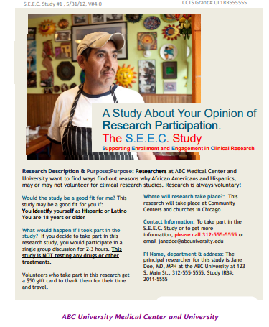
C Signs
Another common way to learn about research
Have to include certain appointment details
Need to get people’s attention
What advice would you give to the Principal Investigator to make the sign most useful?
Notes:
Third point: Introduce the member biographies we will put together and give to every member so they have their contact information.

Slide 117
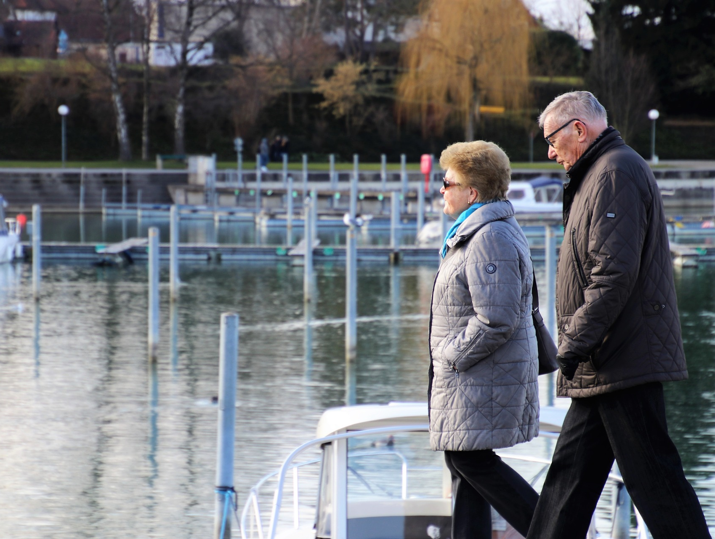
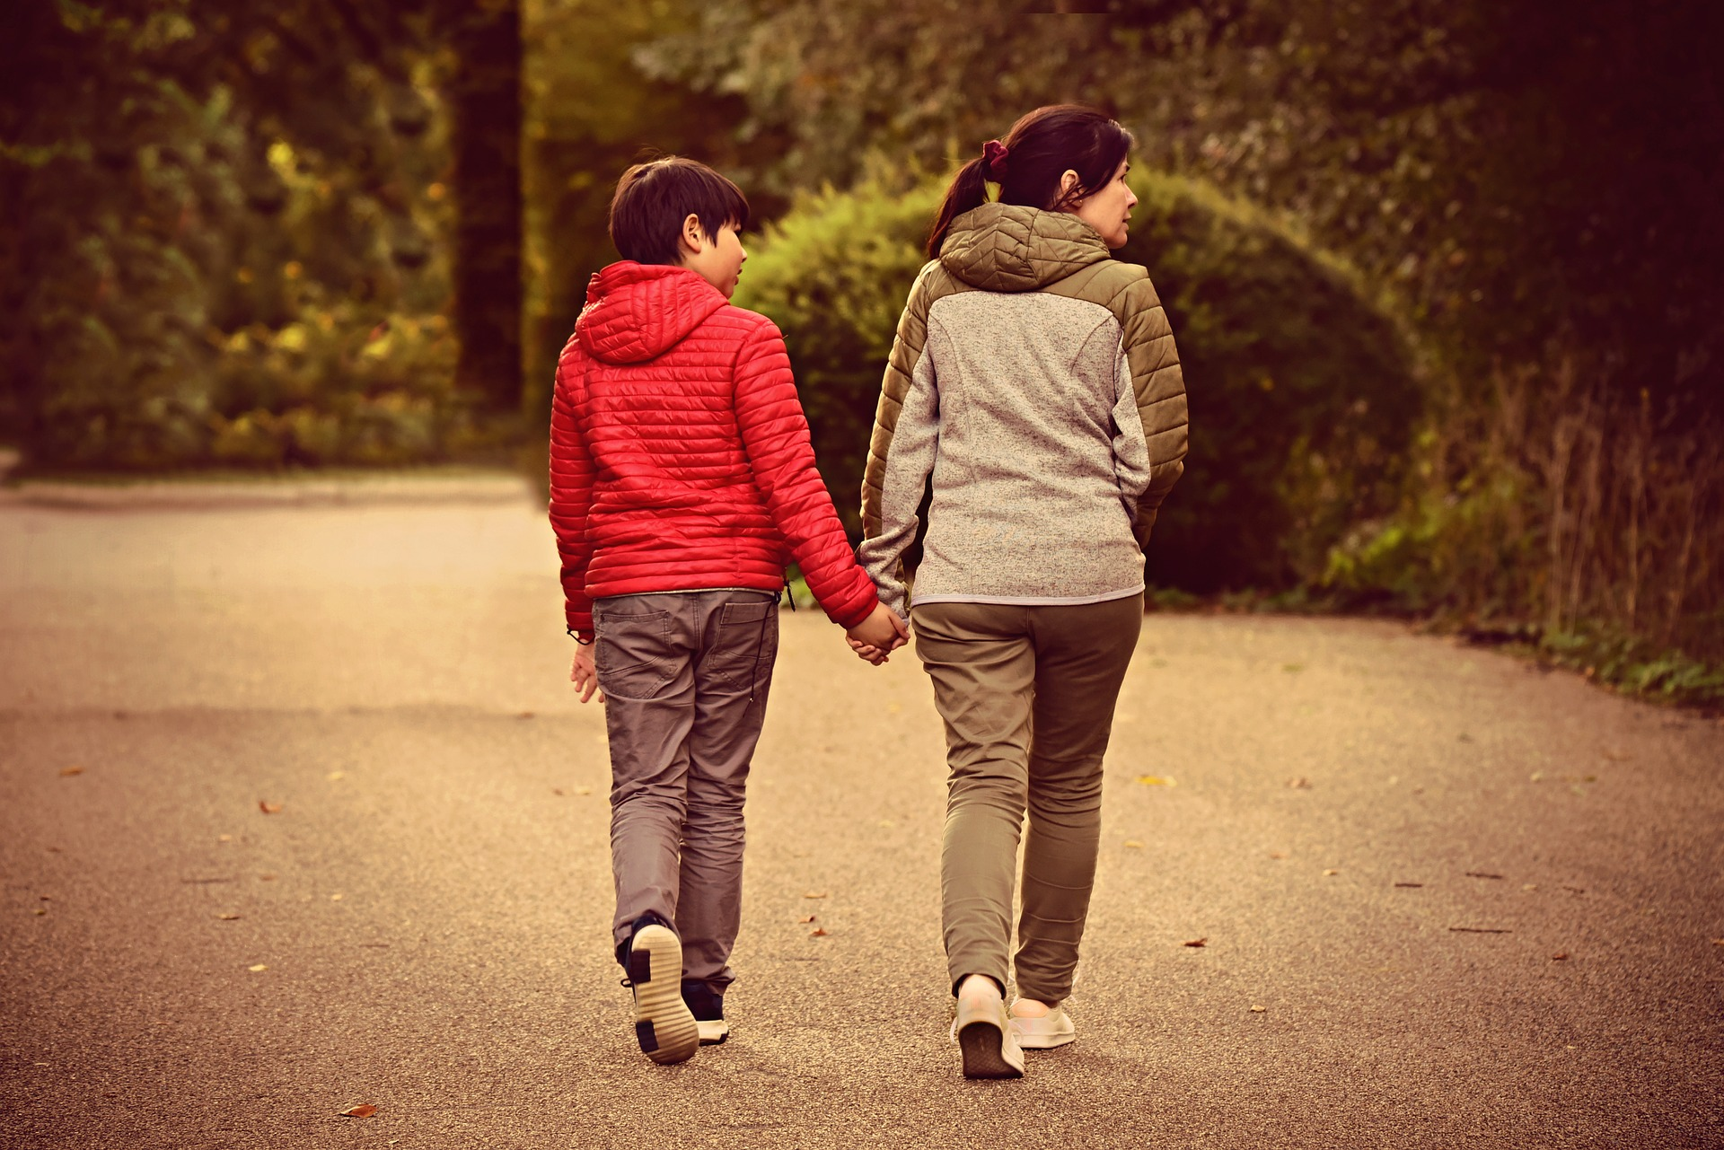
Explaining ideas to patients
Image by Mabel Amber, still incognito... from Pixabay
Image by pasja1000 from Pixabay

Slide 118
References
Chicago Hospitals Strive to Increase Life Expectancy on West Side. WTTW News. https://news.wttw.com/2018/04/10/chicago-hospitals-strive-increase-life-expectancy-west-side
Graziano, A. & Raulin, M. (1993). Research Methods – A process of inquiry. 2nd. Edition. Harper Collins College Publishers.
Holder, Sarah, Montgomery D. & CityLab. (2019, June 18). Segregated Cities Have the Most Distinct Life Expectancy Gaps. Retrieved from https://www.citylab.com/equity/2019/06/segregation-life-expectancy-study-research-racism-map/591028/
Jonas, W. (2018). How Healing Works. Lorena Jones Books. 1st. Edition.
Karanicolas, P., Farrokhyar, F., & Bhandari, M. (2010). Blinding: Who, what, when, why, how? Canadian Journal of Surgery, 53(5), 345–348. Retrieved 21 August, 2015, from http://www.ncbi.nlm.nih.gov/pmc/articles/PMC2947122/
Maternal mortality: An American crisis. (2018, August 05). Retrieved from https://www.cbsnews.com/news/maternal-mortality-an-american-crisis/
Milgram experiment on obedience. (n.d.). Retrieved from https://www.khanacademy.org/test-prep/mcat/behavior/social-psychology/v/milgram-experiment-on-obedience
Reynolds G. The Stuttering Doctor's 'Monster Study'. The New York Times. https://www.nytimes.com/2003/03/16/magazine/the-stuttering-doctor-s-monster-study.html. Published March 16, 2003.
10 facts on health inequities and their causes. World Health Organization. https://www.who.int/features/factfiles/health_inequities/en/. Published April 21, 2017.
Placeholder images from pixabay.com and openclipart.com

